Slide 1
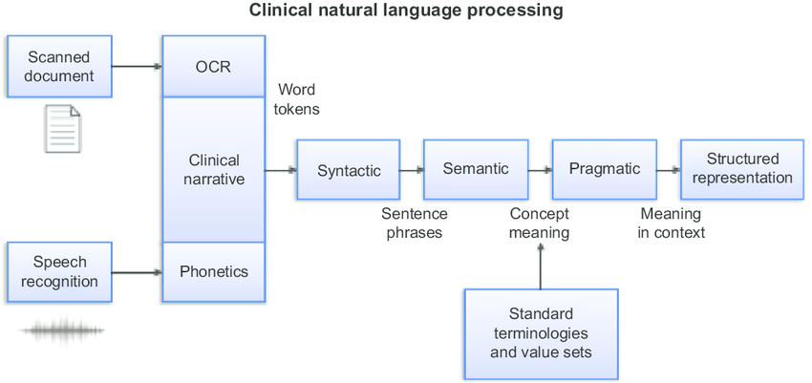


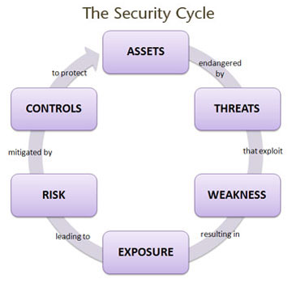
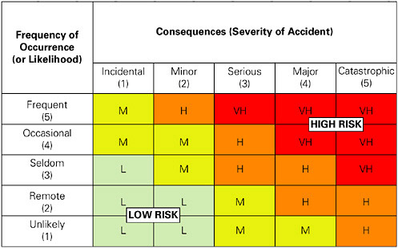
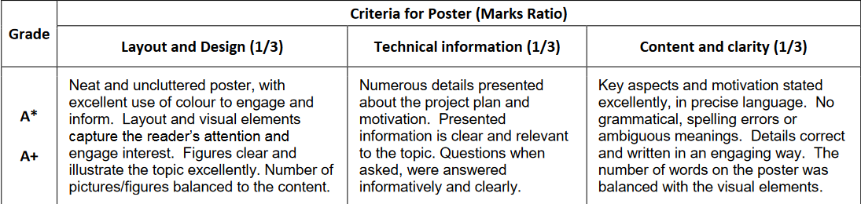
TITLE OF THE POSTER
Start with the motivation by showing the steps of the game and where the issues lie.
Explain the steps of the game in a couple of images
Explain the problematic
Show the study
Start by presenting the game
Show the NLP process and what we jope to achieve
Explain what NLP is and the possible use for this case
BUT MORE IMPORTANTLY WHO how it could be used for other purposes (commercial, research, …)
Example of cycle showing what the processing will look like
Talk about the ISO27001 and the elements used to assess the behavior of the players
Show the combination of the 2 elements
Other topic
Explain the recognition of the main elements + exctract and compare the decisions made for these elements and assess with a preconstructed risk assessment matrix
HERE WE COULD SHOW THE FINALISED PROJECT WITH
GAME + recording + report for companies
Commercial purpose
Other purpose

